Slide 1
Why Writing a Pinch-to-Zoom Component Is Harder Than You Think
Oli Legat
AG Grid

Slide 2

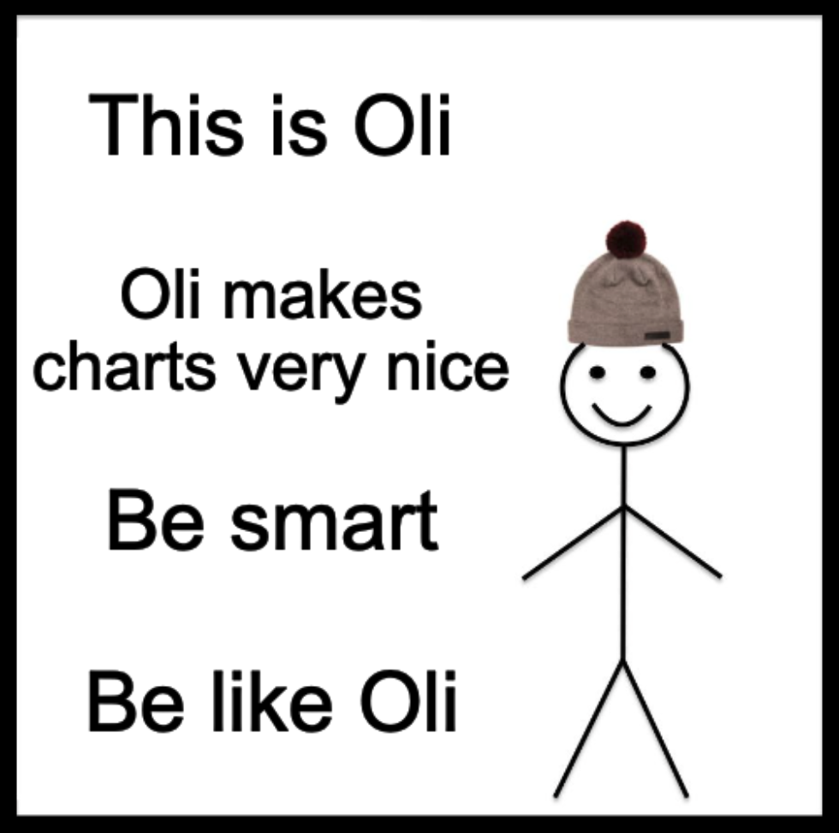

Slide 3
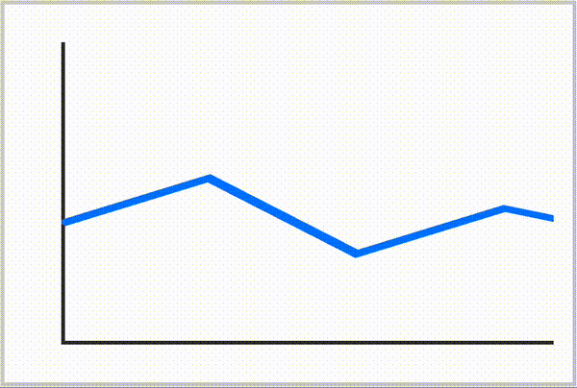

Problem Statement
Panning:
Move Two Fingers
Zooming:
Pinch/Spread Two Fingers
Notes:
Earlier this year, it was decided to add Touch support to the AG Charts Zoom feature
We wanted two new features:
Panning by moving 2 fingers.
Zooming by pinching/spread

Slide 4
The Classic Solution
Calculate the center of two touches
Use this to adjust the Pan
Calculate the distance between the two touches
Use this to adjust the Zoom
Notes:
Explain:
Touch-Center → Pan
Touch-Distance → Zoom
Clarify:
Okay for Images & Maps (where the X/Y aspect ratios are locked).

Slide 5
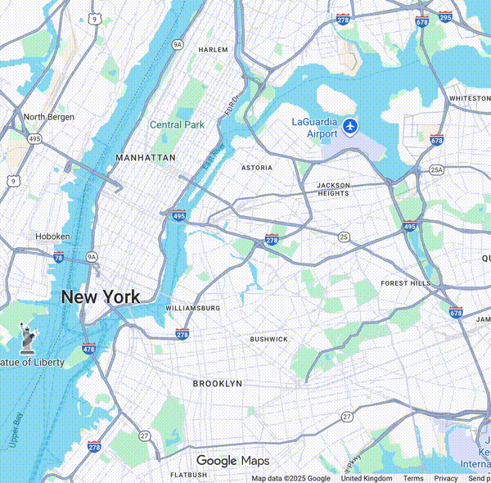
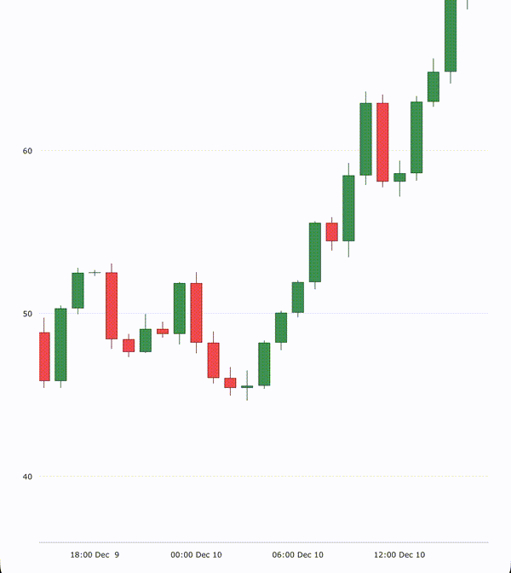
Problems With Classic Solution
Notes:
Explain:
We want X & Y axis to be independent
Oh and reminder, we also want Panning to work.

Slide 6

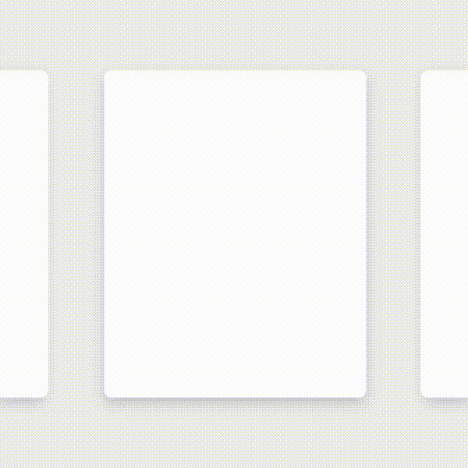
“Realistic” Touch UX Design
Good
Bad
Animation Source: https://m2.material.io/design/interaction/gestures.html#properties
Notes:
Let’s take a step back. How can we design Touch features that deliver the good user experience?
Fortunately, there are some guidelines on this. What we want to ensure, is that our touch gestures are “realistic”
Explain that “Realistic” means. Let’s imagine what “Realistic” touch gestures would like.

Slide 7
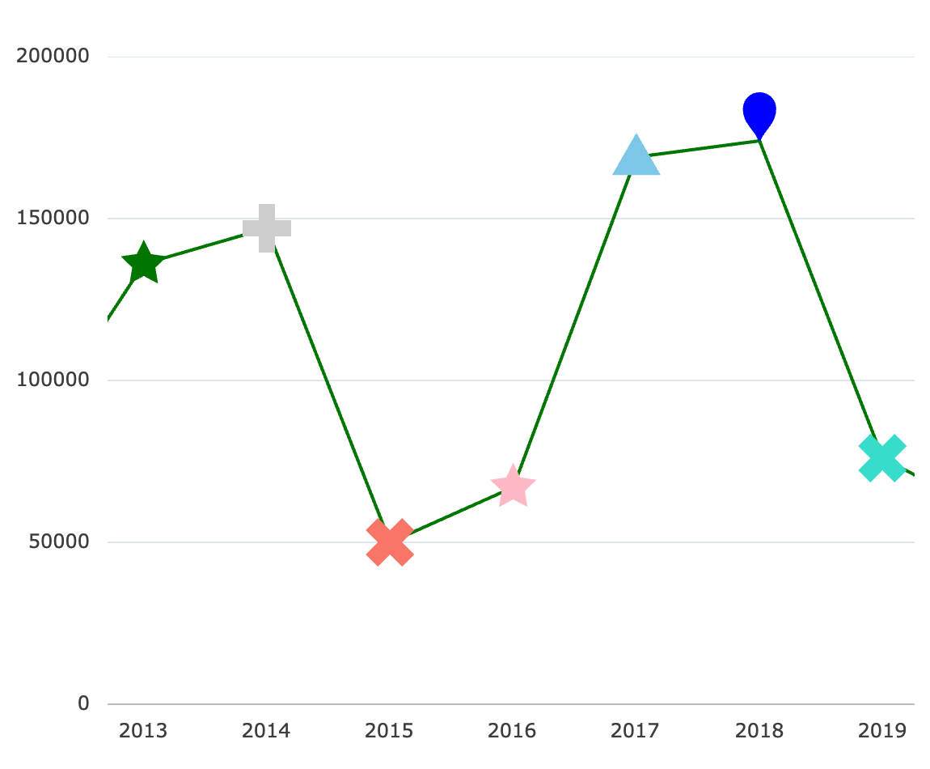


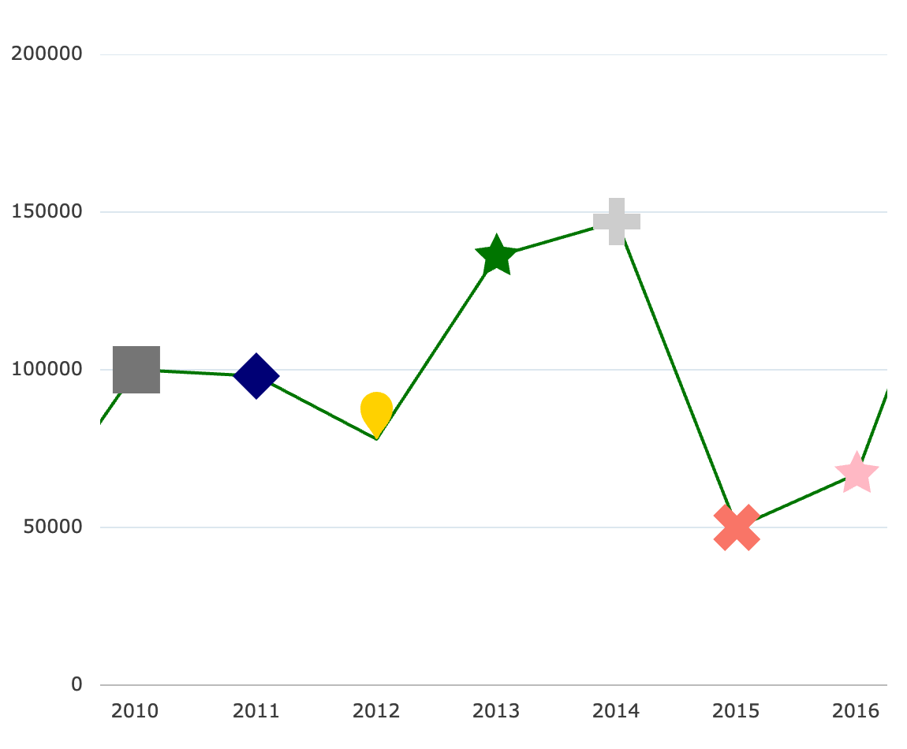
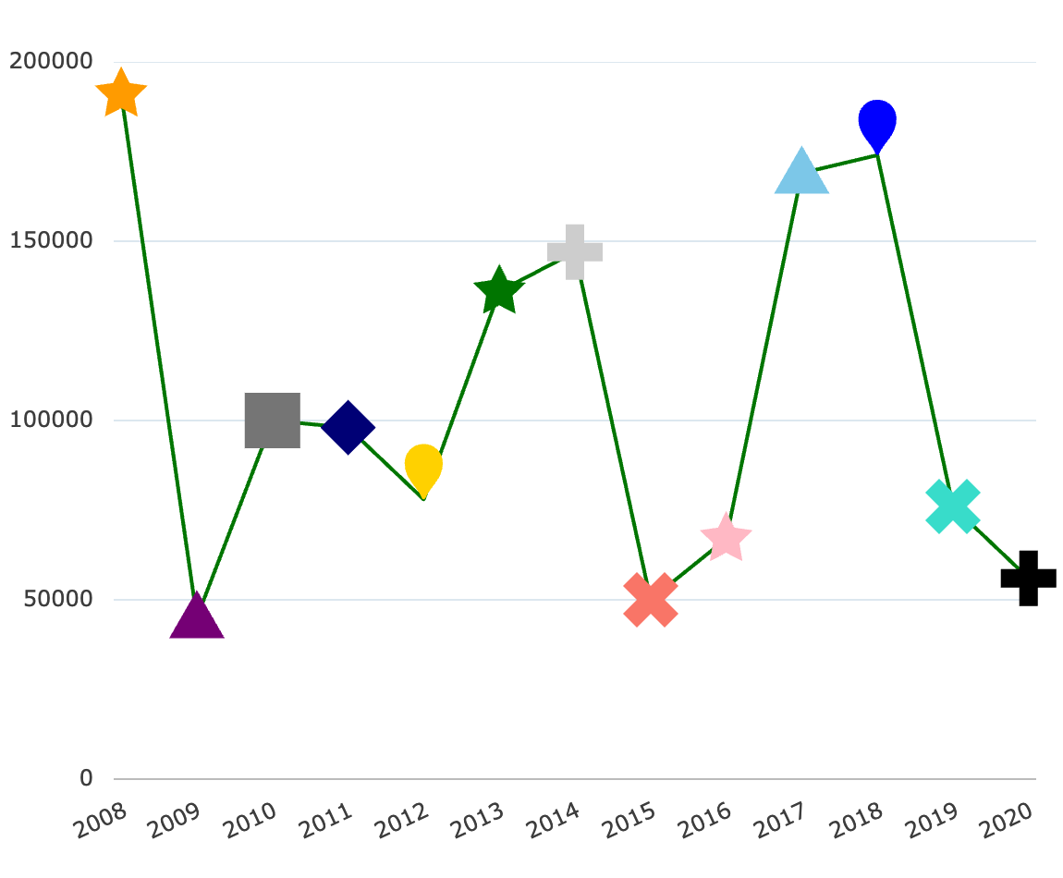
Pan
Zoom
Notes:
Let’s start by visualizing what realistic touch gestures would like for panning (which should be easier).
Now let’s visual what realistic touch gestures would like for zooming (which seems like it could be trickier).
(animation, click click blah blah)
Oh! It’s actually the same thing.

Slide 8
What are we trying to solve?
Notes:
Okay, so I now we fully understand what the behaviour of this feature should be. But it’s hard to intuitively understand what’s the problem that we’re trying to solve.
So let’s simplify things. Forget about the Y-axis for now. In fact, let’s forget about the chart entirely, and just focus on a one-dimensional number line…

Slide 9
'touchstart'
1
2
3
4
5
6
7
8
9
10
'touchmove'
3
4
5
6
7

Slide 10








viewport offset (px)
viewport width (px)
touch offset 1 (px)
touch offset 2 (px)
1
2
3
4
5
6
7
8
9
10

Slide 11








viewport offset (px)
viewport width (px)
new touch offset 1 (px)
new touch offset 2 (px)
3
4
5
6
7

Slide 12
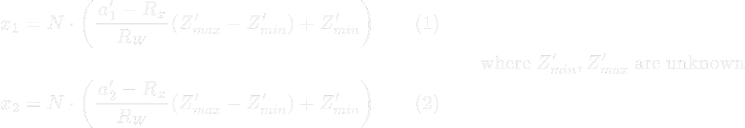

Slide 13
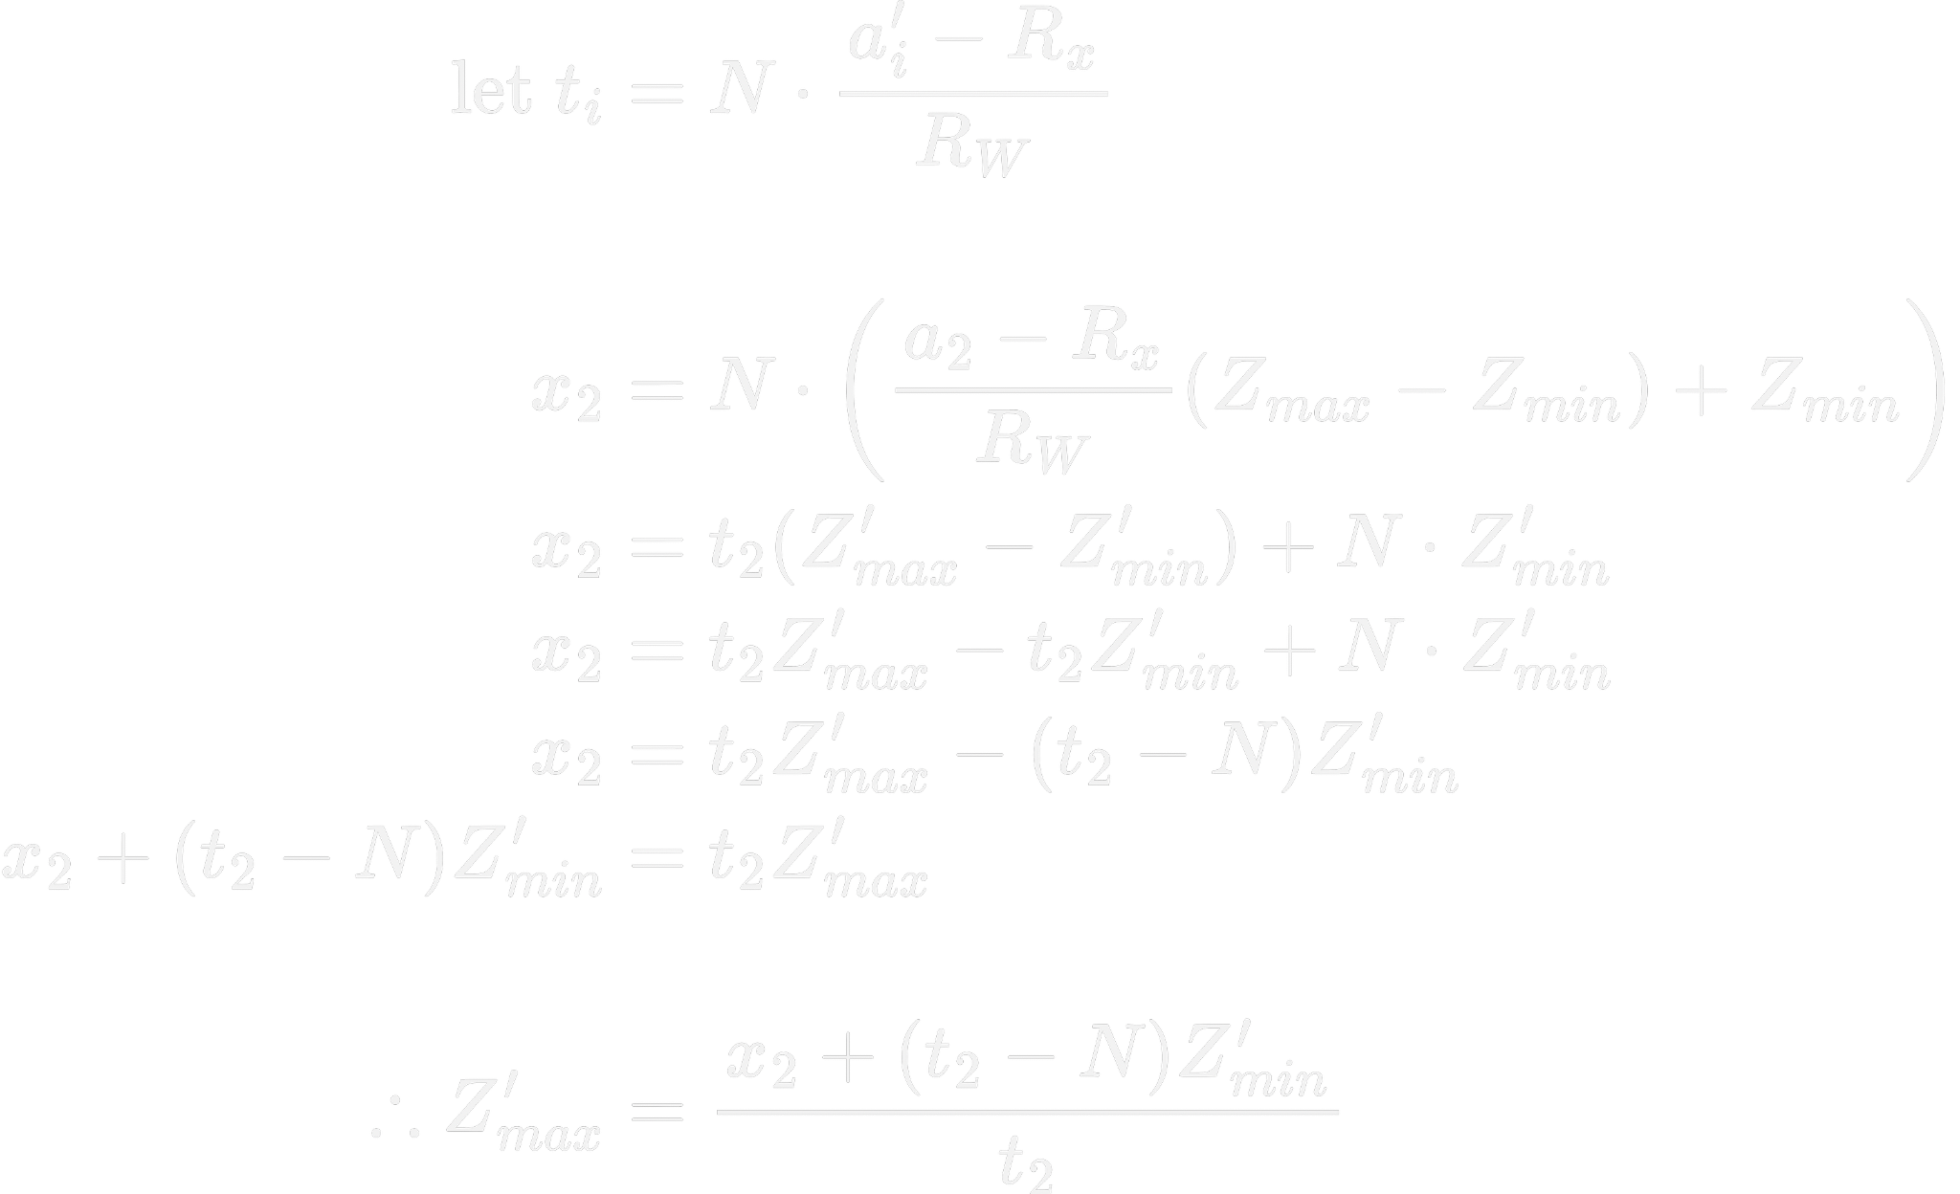
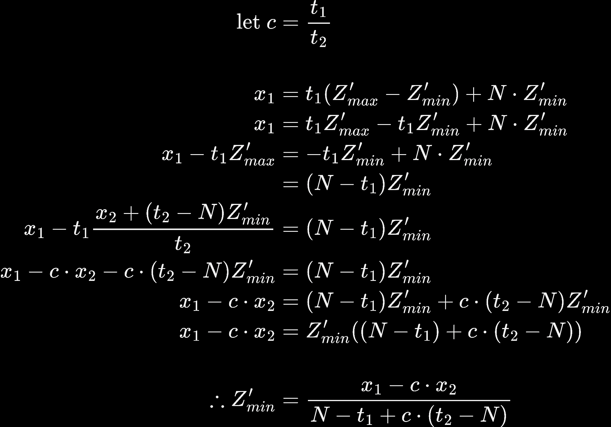

Slide 14
Let’s code it!

Slide 15
const N = 1; type MinMax = { min: number; max: number }; type ClientBounds = { x: number; y: number; width: number; height: number }; type OriginTouch = { identifier: number; normalX: number; normalY: number };
function toNormal( { min, max }: MinMax,
a: number, Rx: number, Rw: number): number
{ if (Rw === 0) return 0; // don't divide by 0. return N * (((a - Rx) / Rw) * (max - min) + min); } export class ZoomPanSolver { private zoom: { x: MinMax; y: MinMax } = { x: { min: 0, max: N, }, y: { min: 0, max: N } };
private readonly origins1: OriginTouch = { identifier: NaN, normalX: NaN, normalY: NaN }; private readonly origins2: OriginTouch = { identifier: NaN, normalX: NaN, normalY: NaN }; handleTouchStart(bounds: ClientBounds, touch1: Touch, touch2: Touch): void { this.origins1.identifier = touch1.identifier; this.origins1.normalX = toNormal(this.zoom.x, touch1.clientX, bounds.x, bounds.width); this.origins1.normalY = toNormal(this.zoom.y, touch1.clientY, bounds.y, bounds.height);
this.origins2.identifier = touch2.identifier; this.origins2.normalX = toNormal(this.zoom.x, touch2.clientX, bounds.x, bounds.width); this.origins2.normalY = toNormal(this.zoom.y, touch2.clientY, bounds.y, bounds.height); } }

Slide 16
function solveTwoUnknowns(x1: number, x2: number, a1: number, a2: number, Rx: number, Rw: number): MinMax { [x1, x2] = [Math.min(x1, x2), Math.max(x1, x2)]; [a1, a2] = [Math.min(a1, a2), Math.max(a1, a2)]; const t1 = (N * (a1 - Rx)) / Rw; const t2 = (N * (a2 - Rx)) / Rw; const c = (a1 - Rx) / (a2 - Rx); // === (t1 / t2); const min = (x1 - c * x2) / (N - t1 + c * (t2 - N)); const max = (x2 + (t2 - N) * min) / t2; return { min, max }; } export class ZoomPanSolver { private zoom: { x: MinMax; y: MinMax }; private readonly origins1: OriginTouch; private readonly origins2: OriginTouch; handleTouchMove(bounds: ClientBounds, touch1: Touch, touch2: Touch): void { const { origins1, origins2 } = this; touch1 = origins1.identifier === touch1.identifier ? touch1 : touch2; touch2 = origins2.identifier === touch2.identifier ? touch2 : touch1; this.zoom.x = solveTwoUnknowns(origins1.normalX, origins2.normalX, touch1.clientX, touch2.clientX, bounds.x, bounds.width); this.zoom.y = solveTwoUnknowns(origins1.normalY, origins2.normalY, touch1.clientY, touch2.clientY, bounds.y, bounds.height); } }

Slide 17
Integrating Our Theory into React
Use a CSS transform
Works on any HTML content.
translation - for Panning
scale - for Zooming
This CSS transform is going to be our useState.

Slide 18
Component State
import { useState } from 'react'; interface ZoomPanProps { src: string; width?: number | `${number}%`; height?: number | `${number}%`; } export default function ZoomPan({ src, width = 400, height = 300 }: ZoomPanProps) { const [transform, setTransform] = useState(`translate(0px, 0px) scale(1, 1)`); return ( <div style={{ width, height, overflow: 'hidden', background: 'lime', touchAction: 'none' }}> <img src={src} alt='Zoomable' style={{ width: '100%', height: '100%', transform, transformOrigin: 'left top' }} /> </div> ); }

Slide 19
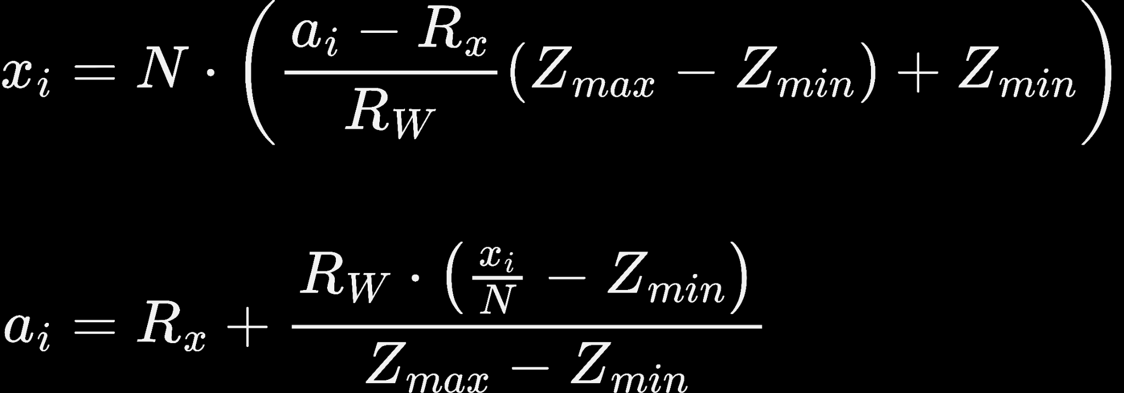
export default function ZoomPan({ src, width, height }: ZoomPanProps) { const containerRef = useRef<HTMLDivElement | null>(null); const { current: solver } = useRef<ZoomPanSolver>(new ZoomPanSolver()); const [transform, setTransform] = useState(`translate(0px, 0px) scale(1, 1)`); const handleTouchStart = (e: React.TouchEvent<HTMLDivElement>) => { if (e.targetTouches.length !== 2 || containerRef.current == null) return; e.preventDefault(); const rect = containerRef.current.getBoundingClientRect(); solver.handleTouchStart(rect, e.targetTouches[0], e.targetTouches[1]); // Initialise the math
}; const handleTouchMove = (e: React.TouchEvent<HTMLDivElement>) => { if (e.targetTouches.length !== 2 || containerRef.current == null) return; e.preventDefault(); const rect = containerRef.current.getBoundingClientRect(); solver.handleTouchMove(rect, e.targetTouches[0], e.targetTouches[1]); // Solve the math setTransform(solver.toCSSTransform(rect)); // Update React state }; return ( <div ref={containerRef} style={{ width, height, overflow: 'hidden', background: 'lime', touchAction: 'none' }} onTouchStart={handleTouchStart} onTouchMove={handleTouchMove} > <img src={src} alt='Zoomable' style={{ width: '100%', height: '100%', transform, transformOrigin: 'left top' }} /> </div> ); }
function toClient(
{ min, max }: MinMax,
x: number,
Rx: number,
Rw: number): number
{ if (max === min) return Rx; // avoid div by 0 return Rx + (Rw * (x / N - min)) / (max - min); } export class ZoomPanSolver { private zoom: { x: MinMax; y: MinMax }; toCSSTransform(bounds: ClientBounds): string { const { x: Rx, y: Ry, width: Rw, height: Rh } = bounds; const tX = toClient(this.zoom.x, 0, Rx, Rw) - Rx; const tY = toClient(this.zoom.y, 0, Ry, Rh) - Ry; const sX = N / (this.zoom.x.max - this.zoom.x.min); const sY = N / (this.zoom.y.max - this.zoom.y.min); return `translate(${tX}px, ${tY}px) scale(${sX}, ${sY})`; } }

Slide 20
Demo

Slide 21

View Code
https://github.com/olegat/ReactSummit2025/
www.ag-grid.com/charts

